Slide 1
Made with love
Radwa Saleh Ismail
Nermeen Moheb Khair
Roaa Essam ElSayed
Sara Ahmed AbdelHafez
Sondos ElSayed Ga’far
Shahd Ibrahim Othman

Slide 2
Project Charter:
Position | Name
Official project name: | Made With Love
Official project sponsor: | Naguib Sawiris
Project Manager: | Roaa Essam ElSayed
Purpose of the project:
To help small start-ups managers reach a larger audience and raise their income
We can exploit all our resources
Preserving the history of handcrafts and supporting it
To open creativity doors for young minds
Increase the company’s revenue and offer more jobs

Slide 3
Business case:
Key deliverables of the project:
Our services to sellers:
They can sell their products on a large platform to reach larger audience
They can feature their products to reach more people
They can compare their prices with other products and set a reasonable price
Our services to customers:
They enjoy scrolling through many options and filtering the results
They can enjoy a delivery service offered by our company
A free exchange and return policy
Better customer service
Company goals | How the project meets it
Increasing revenue | The project aims to increase the company’s revenue by 2 streams: Service fees paid by the sellers as a percentage of the total price of the product sold using the application Premium services of sellers such as featured products
Getting into e-commerce | E-commerce is glowing up really fast these days which would help the company in reaching more customers and increasing its key demographics
Get a better reputation in the market | By helping small business sellers to have a platform where they can increase their sales and revenue, the company should gain a great reputation

Slide 4
General statement:
Collecting information about the project.
Use python in coding the application
Gathering personal data of the people working in crafts and handmade
Timeline:
Week0 – Week3 | Week4 – Week7 | Week8-Week11 | Week 11- Week 13 | Week 14 – Week 15
Defining requirements and working on the software and marketing plan | Working on the online marketing campaign and the development of the application | Continuing working on the application and the offline marketing campaign | Working on the database and middle ware starts | Working on the security systems
Week16 – Week19 | Week20 – Week23 | Week24-Week27 | Week 28- Week 31
Testing starts | Criteria tests are held | Final approval and surveys | Closing and launching

Slide 5
Summary budget:
Feature | details | Min cost | Max cost
Platform | Android | 80000 | 110000
Architecture | Middle size project | 20000 | 25000
Design | MVP (using standard components) | 30000 | 40000
security | Out of the box Security (HTTPS communication) - For initial MVP versions | 25000 | 35000
data | Offline (persistent storage) | 20000 | 25000
Admin and other features | Push Notification Favorites feature (like / dislike) Shopping Cart Search (like Amazon) Rating & reviews (like Yelp) Media Uploading Images Manipulation (Picture parameters / Picture filters / Advanced (colleagues, separate picture elements editing)) Manipulation with Device | 20000 | 20000
Online and offline Marketing | Social media marketing and offline campaigns | 200000 | 260000
Testing | To make sure all the features are working properly | 40000 | 45000
Closing | Final approvals and tests and launching | 40000 | 45000
Total cost = 475,000 – 605,000

Slide 6


Project assumptions: 1- Cost assumptions
2- Software assumptions
3- Schedule assumptions
4- Resources assumptions
Constraints:
1- We must adhere to mentioned schedule. 2- We must offer higher quality application than competitors in the same field. 3- The budget plan must be followed accurately.
High-level risk:
Data loss
Network downtime
Cost risk

Slide 7
Project Scope:
Product Scope description:
This project aims to offer a special product that will help small start-ups and independent talented craftsmen to sell their products on a big platform to reach a higher audience and take their mind of delivers, returns, and exchanges. It also allows customers to scroll through various exceptional products and choose wisely to get without worrying about quality or payment ways.
Product acceptance criteria:
A fully working android and IOS application
A functional dashboard so sellers can upload their products
Backup and Restore testing have been completed successfully.
All requirements have been formally approved.

Slide 8
Project Deliverables:
Proposal
Drawings and documents
Market research
Performance report
Legal registration number and all paper contracts.
Software
Project exclusions:
We do not buy and sell, the application acts as a marketplace (e-commerce platform)
Project constraints:
Deadlines
Cost control

Slide 9
Work breakdown structure:
1.0 online shopping application
1.2 application software plan
1.2.1 front end development
1.2.2 back-end software
1.1 marketing plan
1.1.1 online ads
1.3 testing and releasing plan
1.2.2.1 database implementation
1.1.3 graphics and interface
1.2.2.2 middleware development
1.2.2.3 security subsystems
1.1.2 offline (Banners or TV ads)
1.3.1 preforming creiteria tests
1.3.2 confirm final approval
1.3.3 surveys

Slide 10
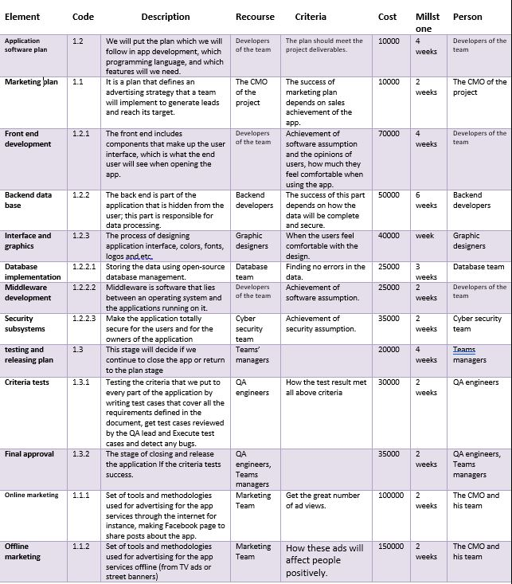
WBS dictionary:

Slide 11
Responsibility matrix:
 | Project manager | Application developer | Database administrator | Marketing manager | Tester
Create the application | C | R |  |  | S
Market research | A |  |  | R
Database management | C |  | R
Testing the application | C | S |  |  | R
Marketing campaign | A |  |  | R
R = Responsible
S = Support
C = Consult
A= Approve

Slide 12
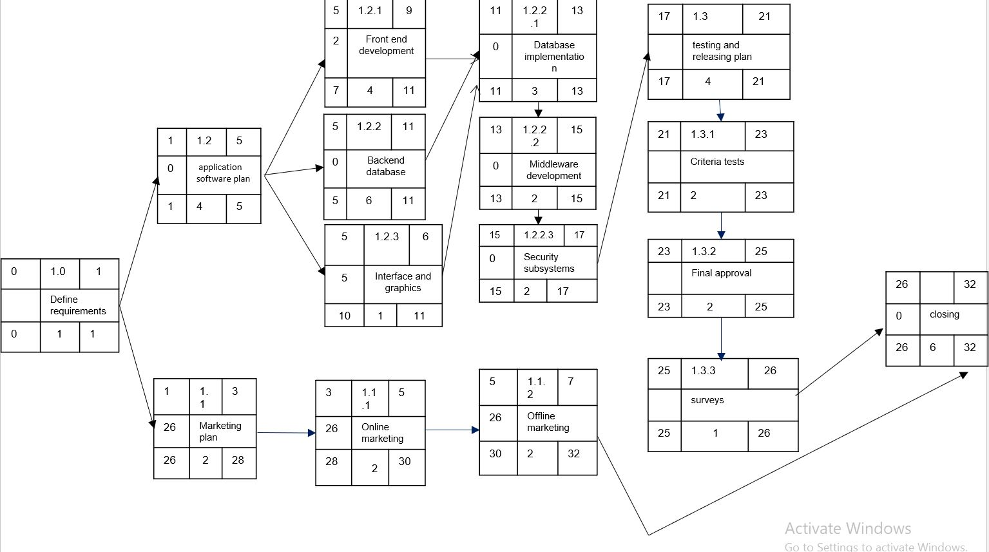
Project network:

Slide 13
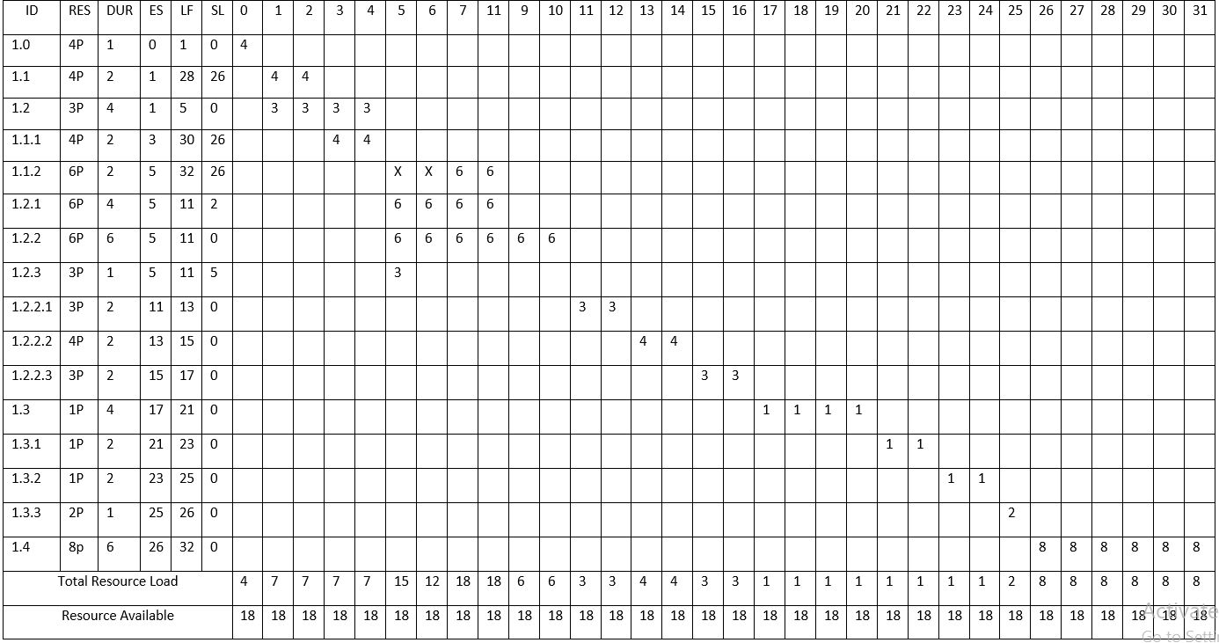
Resource constraints:

Slide 14
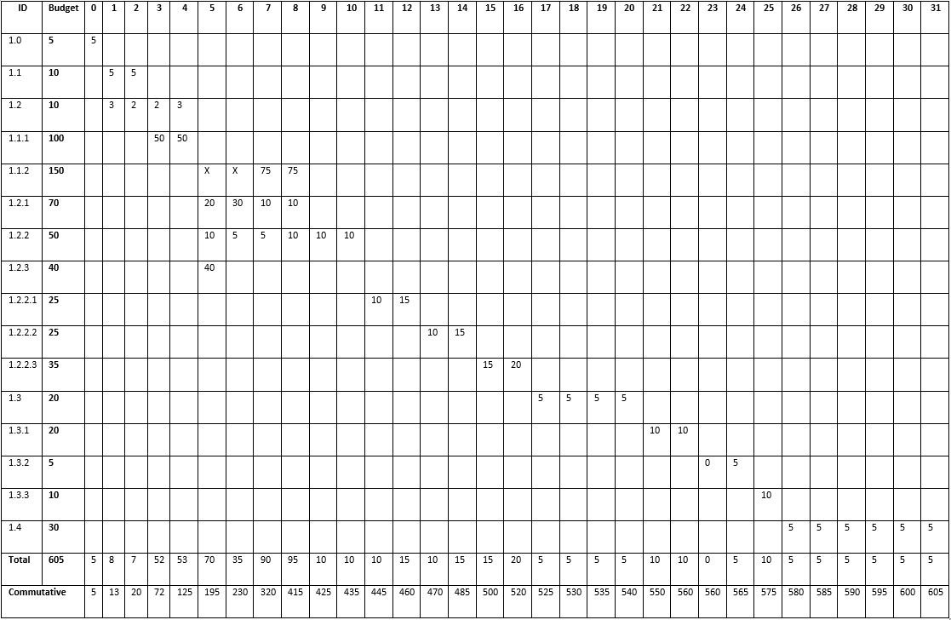
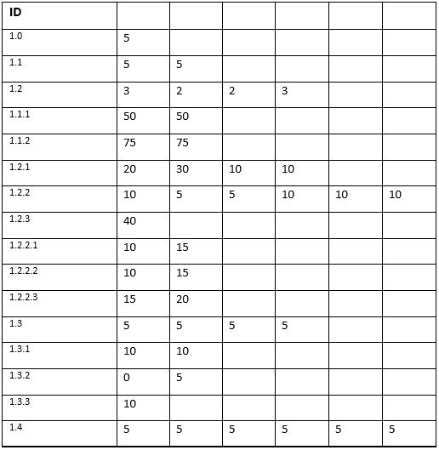
Budget baseline:

Slide 15
Risk monitoring:
Risk | Details | Handling
Data loss | The data of the transactions and orders can get lost or deleted | backup files regularly to multiple locations with encryption.
Network downtime | The application may stop working because of errors with the server | Examine your system for both external and internal weaknesses. Have a redundant network connection. Employ a backup power connection.
Cost risk | The expected cost may be greater than the estimated budget | Research the market efficiently before estimating a certain budget and have a smaller backup budget for emergencies

